Slide 1
Understanding Bunq Bank’s Key Facebook Advertising Demographics
Institute of Data Mini Project
8th August, 2020
Fraser Stark

Slide 2
Presentation Agenda
Hypothesis
Analysis
1
4
Methodology
5
Results
2
Evidence
Summary, Conclusion and Further Steps
3
6

Slide 3
HYPOTHESIS
“While Bunq Bank have invested proportionately more in advertising to the 45 - 49 year-old demographic, they do not represent the most efficient use of Bunq Bank’s marketing budget.”

Slide 4
METHODOLOGY
Export Facebook Marketing Data
Import into & Analyse with Python
Visualise Data with Google Datastudio

Slide 5
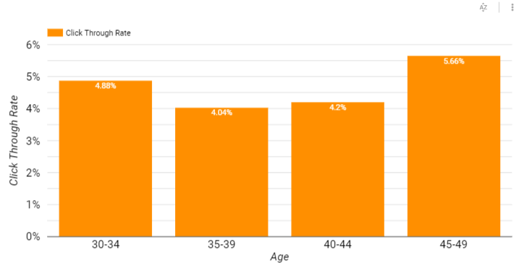
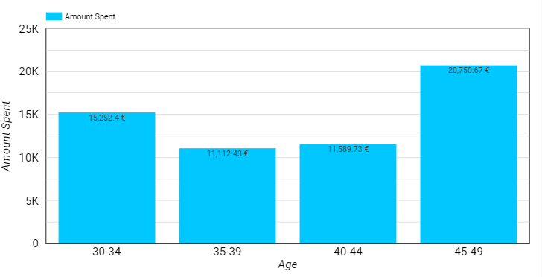
EVIDENCE
Ad engagement measured in Ad Click-Through- Rate segmented by age category.
Marketing revenue spent segmented by age category.

Slide 6
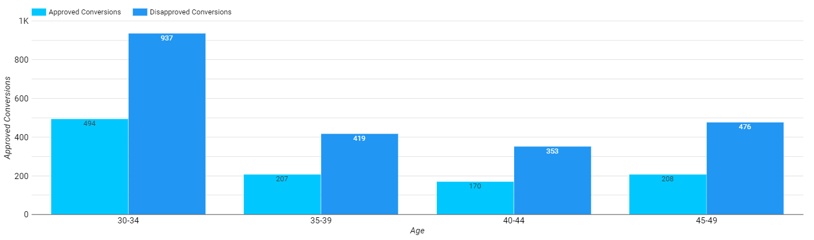
EVIDENCE
Approved vs. Disapproved Conversions segmented by age category.

Slide 7
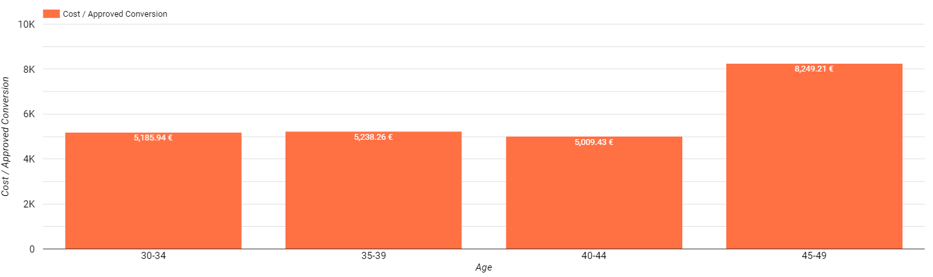
EVIDENCE
Cost per Approved Conversion segmented by age category.

Slide 8
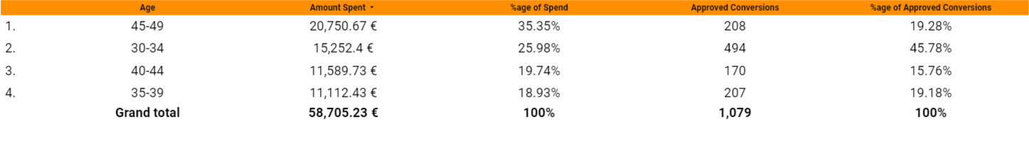
EVIDENCE
Percentage of marketing spend and percentage of approved conversions segmented by age category.

Slide 9
ANALYSIS
As we see from the Bunq bank data, Bunq spent more marketing revenue targeting an age demographic that not only had the highest disapproval rate, but also had the most expensive cost per conversion.
In fact, the 45-49 audience only led results in most spent and best ad engagement. In all positive conversion metrics, all other age demographics performed better with smaller investment.
This proves the hypothesis that the marketing investment into the demographic of 45-49 is not an efficient use of Bunq’s marketing budget.
Metric | Top Performing Age
Lowest Cost per Approved Conversion | 40-44
Lowest Marketing Spend | 35-39
Highest Approved Conversion Rate | 30-34

Slide 10
NEXT STEPS
DATA
Data Analysis
Present Data
Action changes
SOLUTION
Data to be cross- referenced with other dimensions such as audience gender.
Data to be presented to the Marketing Department
Marketing Department to implement strategy amendments based on data analysis.

Slide 11
SUMMARY
Data
Approach
Outcomes
The age demographic of 45-49 consumed 35.35% of our marketing budget over the two week period while only providing 19.28% of our overall approved conversions.
Export marketing data from Facebook.
Upload into Python for data cleansing and analysis.
Import into Google Datastudio for visualisations.
Reduce or stop marketing spend in the age demographic of 45-49.
Increase marketing spend in younger demographics with a higher quality of conversion.

Slide 12
CONCLUSION & NEXT STEPS
CONCLUSIONS
NEXT STEPS
This hypothesis is correct. The age demographic of those aged 45-49 does not represent an efficient use of marketing budget
Repeat process to segment metrics by the following dimensions:
1) Gender
2) Day of the Week

Slide 13
THANK YOU
Do you have any questions?

